Slide 1

BOOK RECOMMENDATION SYSTEM USING COLLABORATIVE FILTERING
Project Supervisor:Dr.G.Nagarajan M.E.,(Ph,D)
Name of the Student:Mehul Raj
Register Number: 40110751

Slide 2
Presentation Outline
Course Certificate
Introduction
Objectives
System Architecture / Ideation Map
Module Implementation
Sample Snapshots
Results and Discussions
Conclusion & Future work
References

Slide 3
Course Certificate

Slide 4
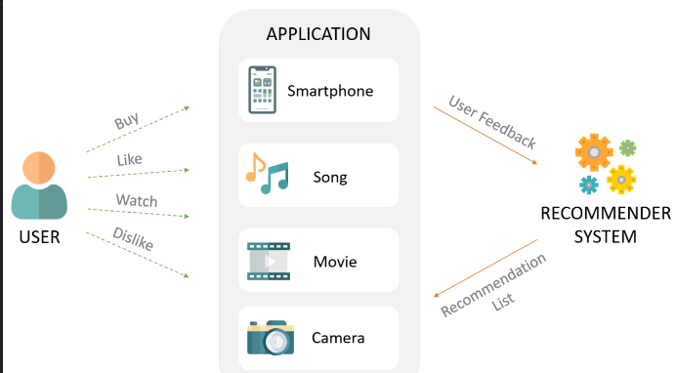
Introduction
The objective of this project is to build a recommendation system for books based on user ratings and book attributes.
The data used in this project consists of three datasets: books, users, and ratings.
The popularity-based recommender system is built using the count and average ratings of books, and is suitable for users who prefer popular books.
The collaborative filtering-based recommender system is built using user-book ratings, and is suitable for users who prefer personalized recommendations.
The cosine similarity algorithm is used to compute the similarity between books in the collaborative filtering system.
Both the systems are evaluated using a sample of users and books, and are found to be effective in recommending books.
The future work for this project includes scaling up the systems to handle larger datasets, and incorporating other features such as genre, language, and author information to improve the recommendations.

Slide 5
Objectives
The objective of this project is to build a recommendation system to suggest books to users based on two different methods.
The first method is a popularity-based recommender system which recommends books based on their popularity and average rating.
The second method is a collaborative filtering-based recommender system which recommends books based on the similarity of users' ratings.
The recommendation system will assist users in discovering new books they may be interested in reading, based on their past preferences and behavior.
The project aims to improve the user experience on the book website, increase user engagement, and drive sales by suggesting books that match user interests and preferences.

Slide 6
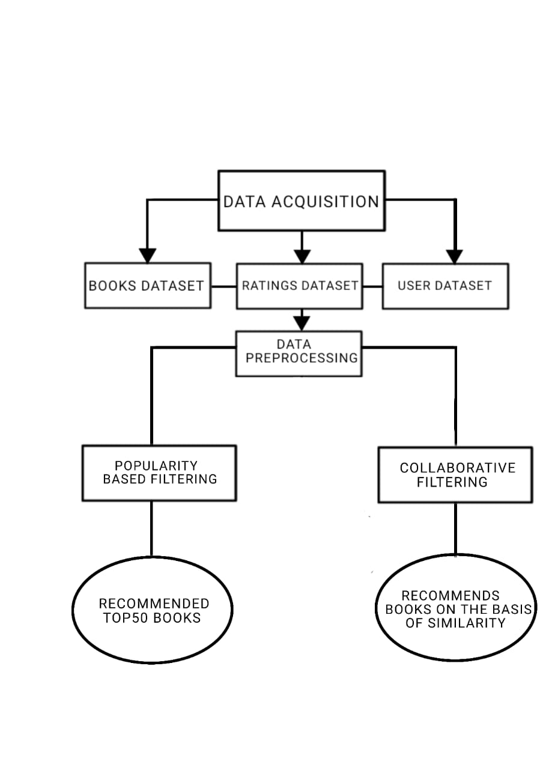
System Architecture/ Ideation Map
11 November 2021
Department of CSE
6

Slide 7
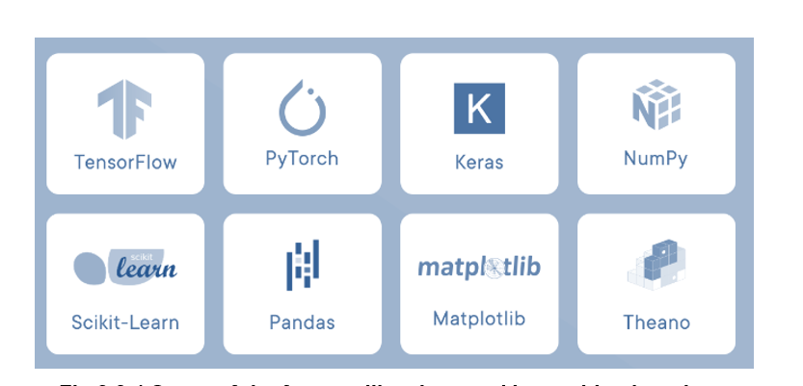
Module Implementation
IMPORTED LIBRARIES
Libraries are collections of prewritten code that users can use to optimize tasks. In project as python is used for implementation tool, it has the most libraries as compared to other programming languages.
More than of 60% machine learning developers use and goes for python as it is easy to learn.
SOME OF THE FAMOUS LIBRARIES USED IN MACHINE LEARNING

Slide 8
Module Implementation
PANDAS
Pandas is a widely-used data analysis and manipulation library for python. It provides a lot of functions and methods that ease the data analysis and preprocessing steps.
It also provides fast, flexible and expressive data structures working with relational or labeled or both easy.
NUMPY
NumPy is a library consisting of multidimensional array objects and a collection of countless of routines for processing those arrays.
Using this mathematical and logical operations on arrays can be performed. The difference in using NumPy from pandas is, it works on numerical data whereas pandas on tabular data.

Slide 9
Module Implementation
SKLEARN
Sklearn stands for Scikit-learn, a machine learning library. It is imported for various classification, regression and clustering algorithms
From the Sklearn library and from the tree inside the library Decision Tree Classifier. It is a class capable of performing multi-class classifier on a dataset.
PICKLE
Pickling is the process of converting a Python object hierarchy into a byte stream, and unpickling is the inverse operation, i.e., the process of converting a byte stream back into a Python object hierarchy.
Pickling is commonly used in machine learning projects to save trained models and datasets to disk, so that they can be easily reloaded for further analysis or use

Slide 10
Module Implementation
HTML
HTML is used to structure content on the web, including text, images, videos, and links.
HTML files are plaintext documents that are interpreted by web browsers to display web pages.
CSS
CSS is used to add style and layout to web pages, including typography, colors, spacing, and positioning.
CSS works by selecting HTML elements and applying styles to them using selectors and declarations

Slide 11
Module Implementation
BOOTSTRAP
Bootstrap provides a set of pre-designed templates, styles, and components for web development, allowing developers to build websites quickly and efficiently.
Bootstrap is based on HTML, CSS, and JavaScript, making it compatible with different browsers and devices.
FLASK
Flask is lightweight and flexible, making it easy to get started with web development.
Flask uses Python's built-in web server and has a modular design that allows developers to add or remove components as needed.

Slide 12
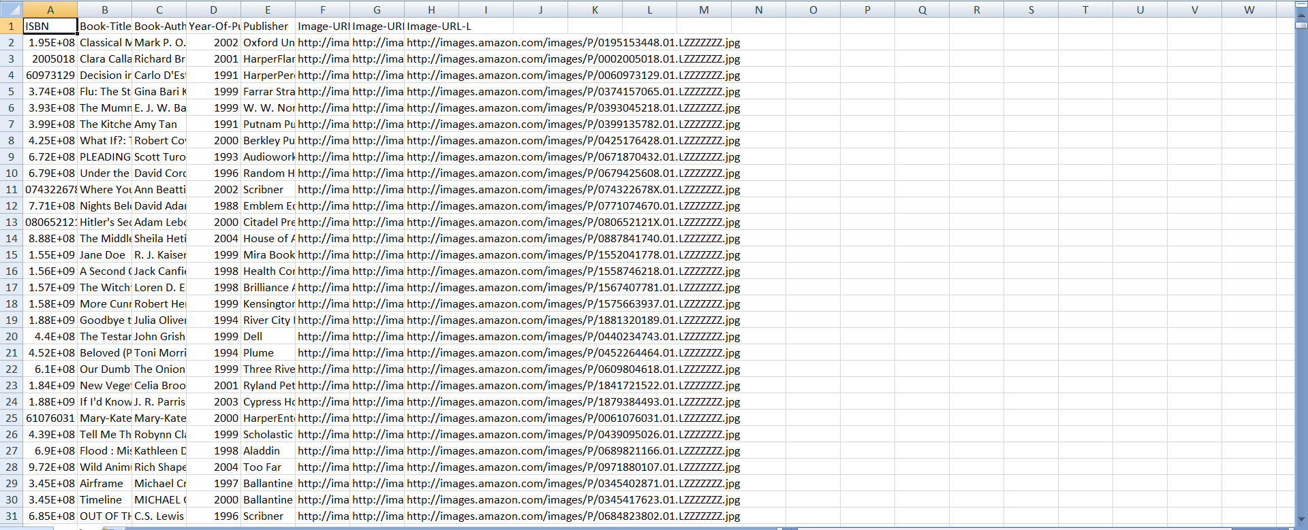
Sample Snapshot
Data Set :-

Slide 13
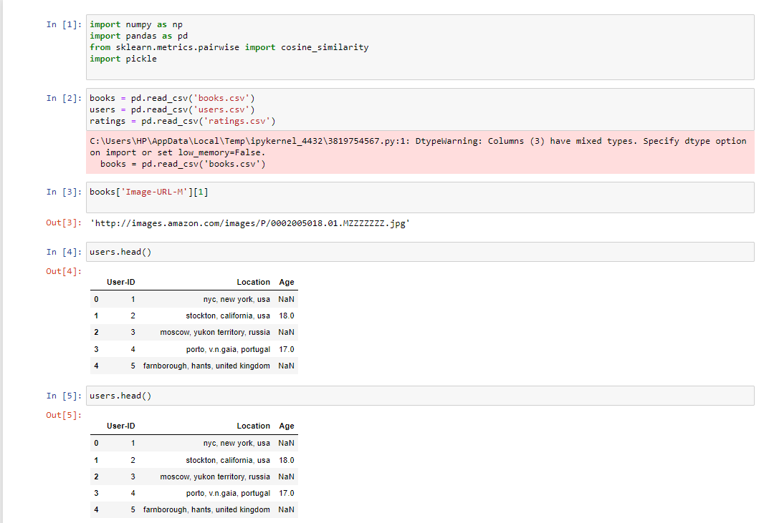
Sample Snapshot
Python code:

Slide 14
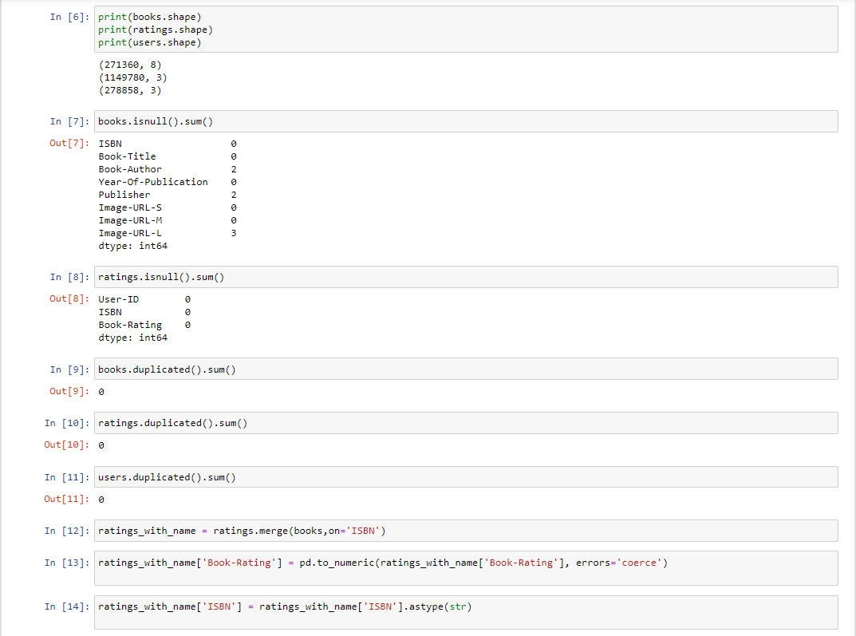
Sample Snapshot

Slide 15
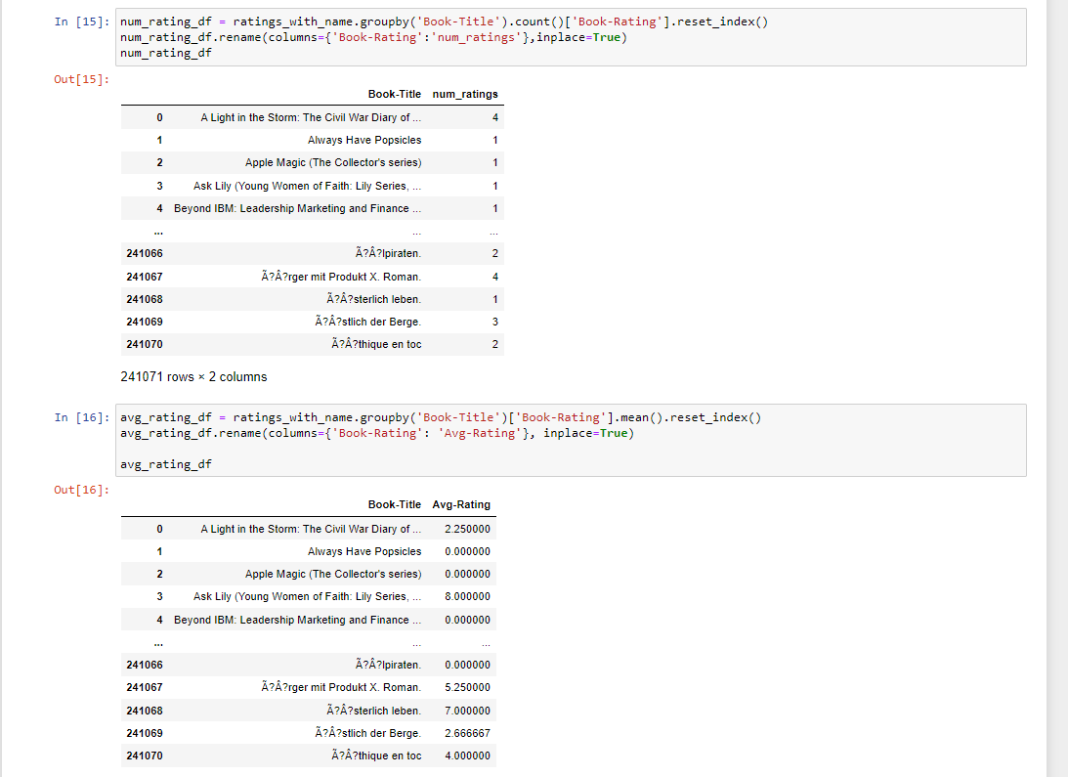
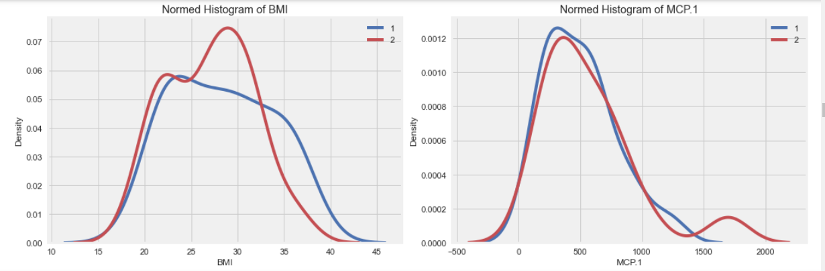
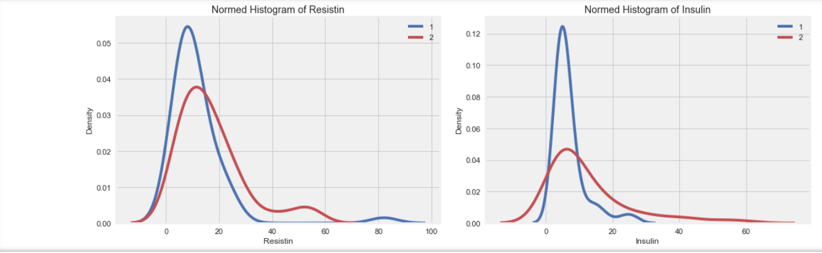
Sample Snapshot

Slide 16
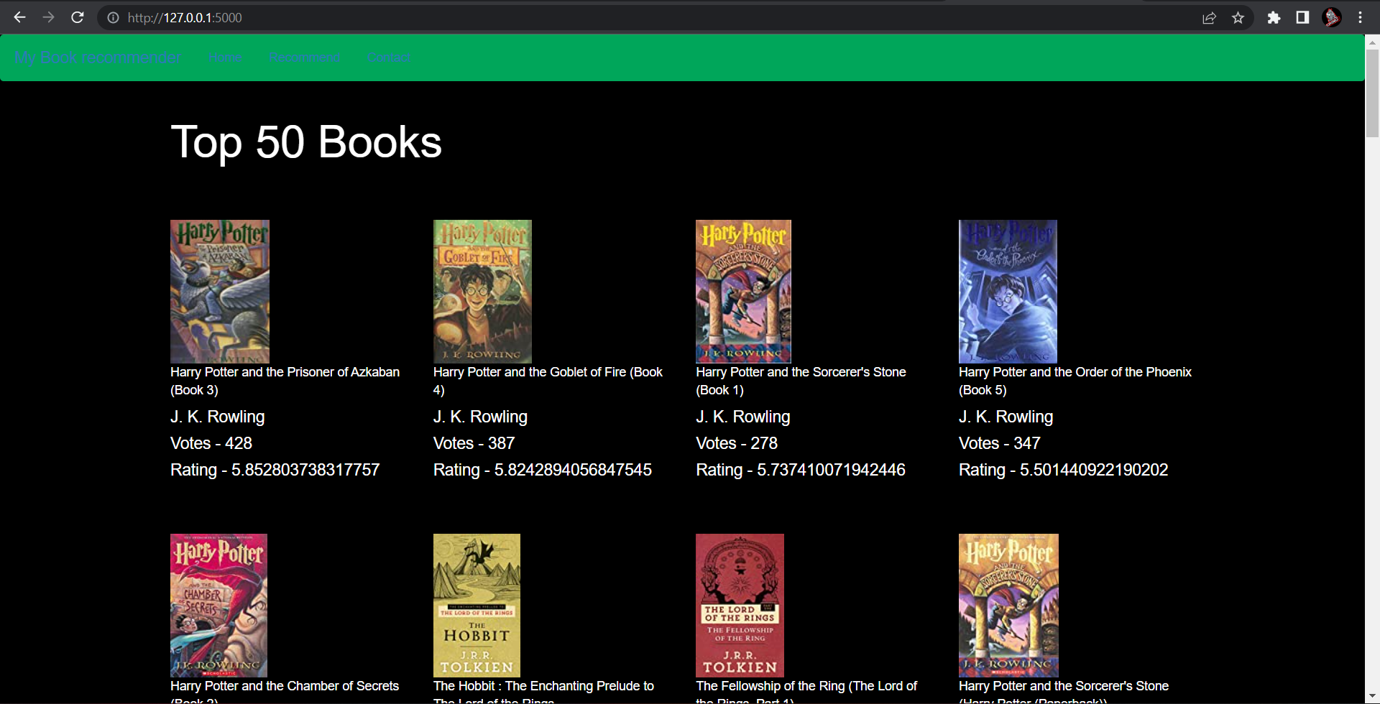
Sample Snapshot

Slide 17
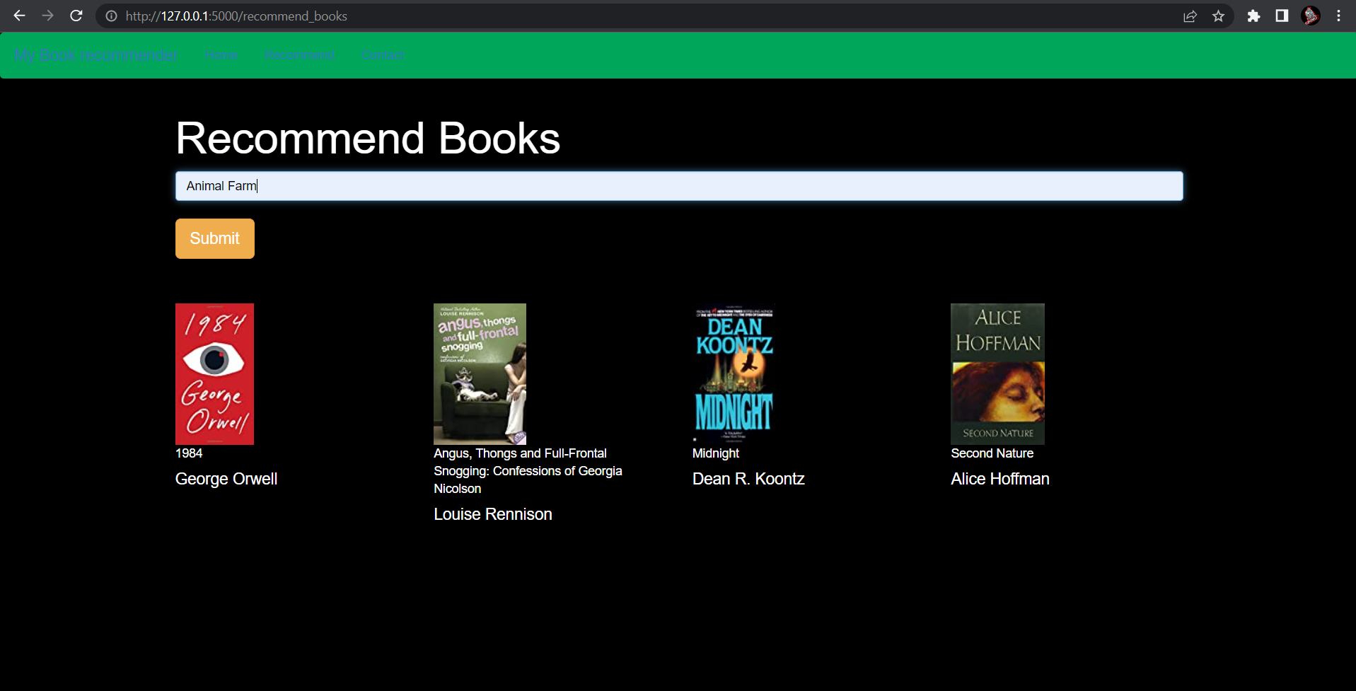
Sample Snapshot

Slide 18
Results and Discussion
RESULT
The project aimed to build a recommender system using two different approaches - Popularity-based and Collaborative Filtering-based.
The popularity-based recommender system focused on recommending books based on their popularity among the users, while the collaborative filtering-based system relied on identifying similar users and their book choices to make recommendations..

Slide 19
Results and Discussion
DISCUSSION
The popularity-based recommender system was able to recommend popular books that received a high number of ratings from users. However, this approach may not provide personalized recommendations to users and may not be suitable for niche book genres.
On the other hand, the collaborative filtering-based system was able to provide personalized recommendations by identifying similar users and their book choices. This approach is more suitable for niche genres and is more likely to provide recommendations that match the user's preferences.

Slide 20
Conclusion And Future Work
The popularity-based system recommends books based on their popularity and average rating. It is a simple and effective method, but it does not take into account the user's individual preferences.
On the other hand, the collaborative filtering-based system recommends books based on the user's past interactions and similar user's choices. It is a more personalized approach that provides better recommendations to the user.
In addition, we have explored various data cleaning techniques and visualizations to gain insights into the dataset.
There are several areas in which this project can be expanded and improved. One of the limitations of the collaborative filtering-based system is the cold-start problem, where new users or books have insufficient data for the system to provide accurate recommendations. To address this, we can use content-based filtering or hybrid filtering methods.
Another area for future work is to incorporate sentiment analysis of the book reviews, which could provide additional insights into user preferences and help to improve the recommendation accuracy.

Slide 21
References
Data Set:
https://www.kaggle.com/datasets/arashnic/book-recommendation-dataset
Medium Article:
https://medium.com/specialist-library-support/describing-your-statistical-data-2baa6d014e26
Javatpoint:
https://www.javatpoint.com/machine-learning
Youtube Video References:
https://www.youtube.com/watch?v=dGNJ-feQLC4

Slide 22
References
Avi Rana and K. Deeba et.al, “Online Book Recommendation System using Collaborative Filtering (With Jaccard Similarity)” in IOP ebooks 1362, 2019.
G. Naveen Kishore, V. Dhiraj, Sk Hasane Ahammad, Sivaramireddy Gudise, Balaji Kummaraa and Likhita Ravuru Akkala, “Online Book Recommendation System” International Journal of Scientific & Technology Research vol.8, issue 12, Dec 2019.
Uko E Okon, B O Eke and P O Asaga, “An Improved Online Book Recommender System using Collaborative Filtering Algorithm”, International Journal of Computer Applications vol.179-Number 46, 2018. ] Jinny Cho, Ryan Gorey, Sofia Serrano, Shatian Wang, JordiKai Watanabe-Inouye, “Book Recommendation System” Winter 2016.
Ms. Sushma Rjpurkar, Ms. Darshana Bhatt and Ms. Pooja Malhotra, “Book Recommendation System” International Journal for Innovative Research in Science & Technology vol.1, issue 11, April 2015.
Abhay E. Patil, Simran Patil, Karanjit Singh, Parth Saraiya and Aayusha Sheregar, “Online Book Recommendation System using Association Rule Mining and Collaborative Filtering” International Journal of Computer Science and Mobile Computing vol.8, April 2019.
Suhas Patil and Dr. Varsha Nandeo, “A Proposed Hybrid Book Recommender System” International Journal of Computer Applications vol.6 – No.6,Nov – Dec 2016.
Ankit Khera, “Online Recommendation System” SJSU ScholarWorks, Masters Theorem and Graduate Research, Master’s Projects, 2008. 58

Slide 23
THANK YOU

